Slide 1
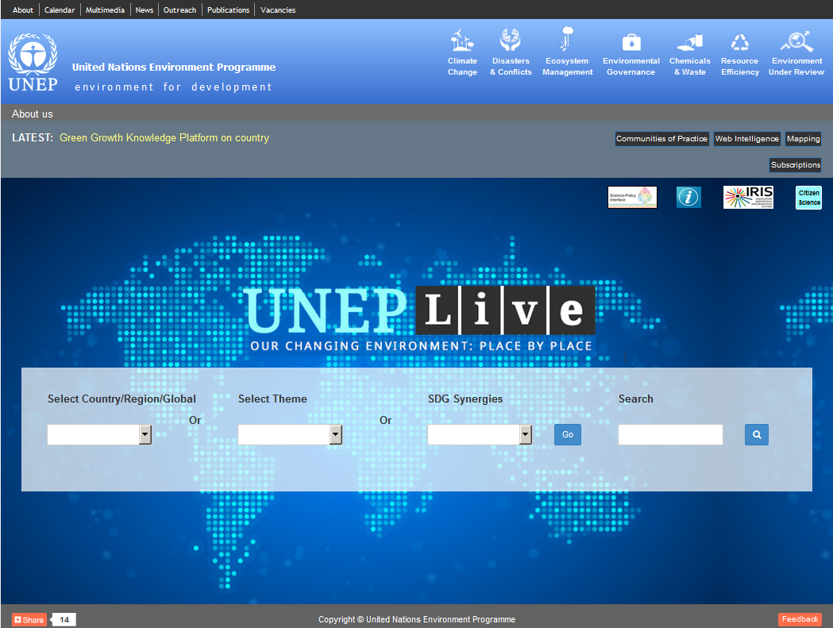
UNEP Live – uneplive.unep.org
agree on deployment,

Slide 2
What is UNEP Live?
On-line knowledge management platform
Focus on open access to global, regional and national environmental data and knowledge
Supports more dynamic, interactive assessment and reporting processes
Range of analytical, mapping, search, visualization tools
SDGs/ MEAs Synergies Portal
Web intelligence portal
Communities of Practice
Principles: Open access; Data managed as close as possible to source; Data collected once and shared for many purposes

Slide 3
Package of UNEP services for monitoring, reporting and data sharing
UNEP Live knowledge management platform
UNEP-Live SDGs Synergies Portal
Indicator Reporting Information System (IRIS)

Slide 4
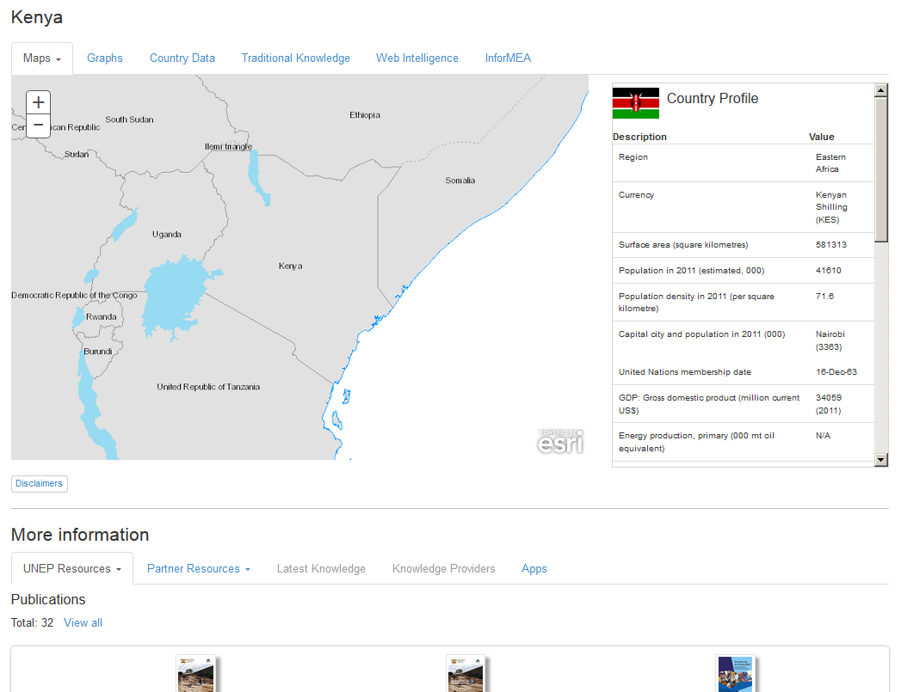
Country data and knowledge

Slide 5
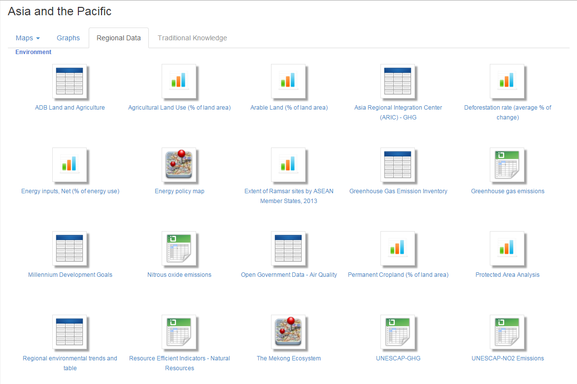
Regional data and knowledge

Slide 6
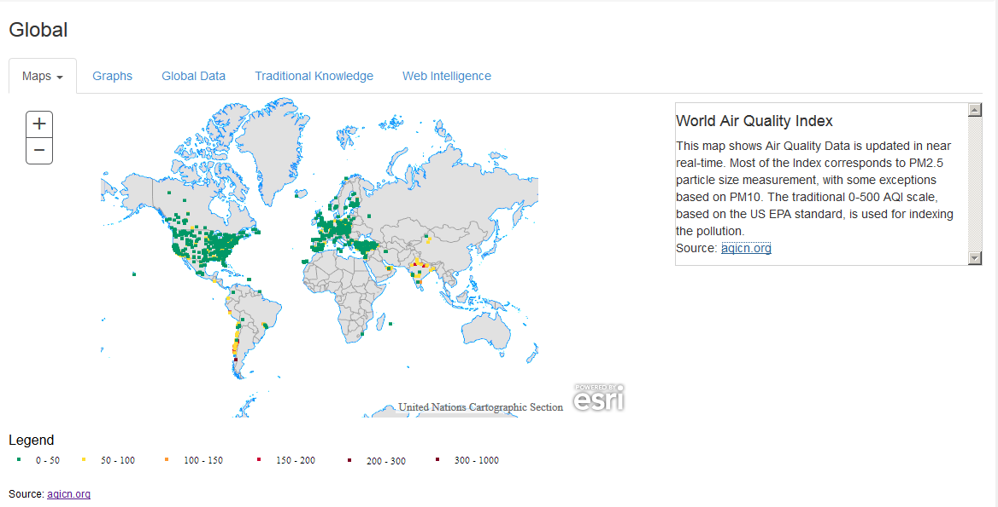
Global data and knowledge

Slide 7
Web intelligence

Slide 8
Mapping

Slide 9
Charting Indicators

Slide 10
Package of UNEP services for monitoring, reporting and data sharing
UNEP Live knowledge management platform
UNEP-Live SDGs Synergies Portal
Indicator Reporting Information System (IRIS)

Slide 12
Environmental dimension of SDGs
17 out of 17 Goals
81 out of 241 global indicators
UNEP is custodian agency for 31 global indicators, collaborating on others
Many links between SDGs and MEAs
UNEP Live contains datasets related to 112 out of 241 indicators
Data is missing for many countries

Slide 13
Example: Tier 1 indicators for which UNEP is expected to be responsible for providing data flows
6.5.1Degree of integrated water resources management implementation (0-100)
12.4.1 Number of parties to international multilateral environmental agreements on hazardous waste, and other chemicals that meet their commitments and obligations in transmitting information as required by each relevant agreement
14.5.1 Coverage of protected areas in relation to marine areas
15.1.2 Proportion of important sites for terrestrial and freshwater biodiversity that are covered by protected areas, by ecosystem type
15.4.1 Coverage by protected areas of important sites for mountain biodiversity
15.a.1 Official development assistance and public expenditure on conservation and sustainable use of biodiversity and ecosystems
15.b.1 Official development assistance and public expenditure on conservation and sustainable use of biodiversity and ecosystems

Slide 14
How MEAs contribute to SDGs

Slide 16
Package of UNEP services for monitoring, reporting and data sharing
UNEP Live knowledge management platform
UNEP-Live SDGs Synergies Portal
Indicator Reporting Information System (IRIS)

Slide 17
Integration: UNEP Live, Assessments, IRIS

Slide 18
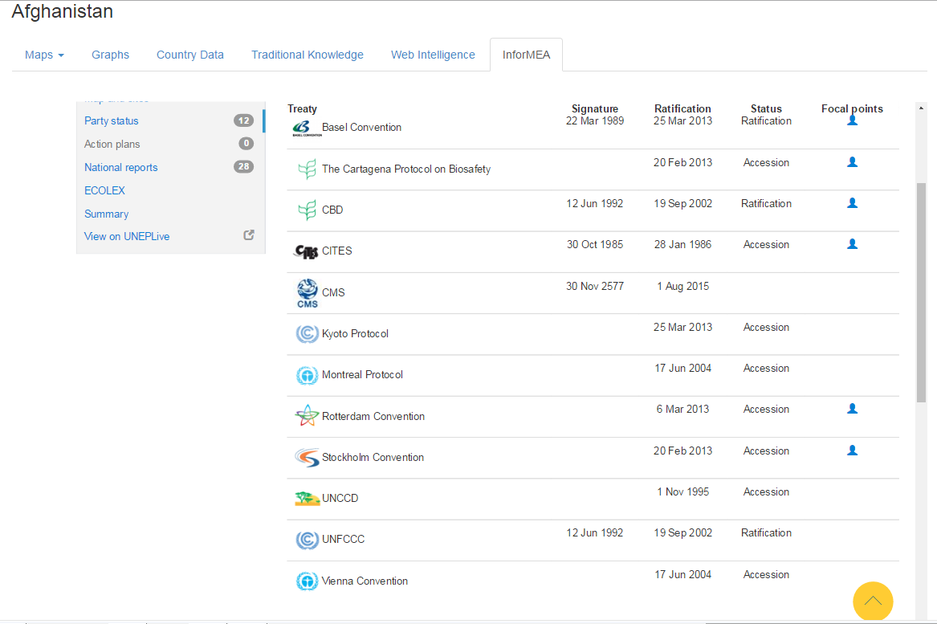
Reporting Obligations

Slide 19
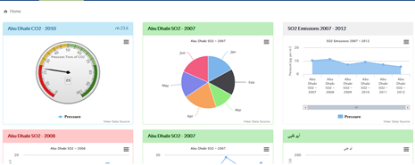
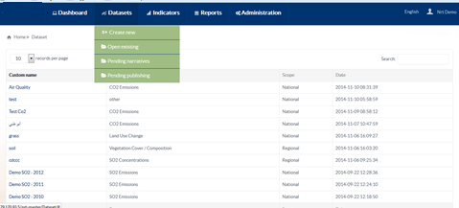
Indicator Reporting Information System
The IRIS aims to help government ministries responsible for reporting on national, regional and global obligations, to collect, analyze and publish quality assured environmental information in a timely manner
The IRIS enables evidence-based, timely decision-making

Slide 20
Indicator Reporting Information System
Dashboard: provides a graphical snap-shot of key data/indicators that together highlight, in a quick, easy way, the state and trends of the environment.
Datasources: users can upload data so they are available for multiple reporting needs. This is the starting point for reporting.
Indicator Workbooks can be generated using formulae’s and multiple datasets and Indicator Instances (chart, map, values) saved for use in reporting
Reports allow users to generate reports, using reporting templates, that bring in relevant datasets and indicators available in the IRIS.
The Administration menu option is not available to all users. Administrators have the option to add new users and upload reporting templates.

Slide 21
Datasources
Upload using an API
Upload from a Database
Upload from an Excel spreadsheet

Slide 22
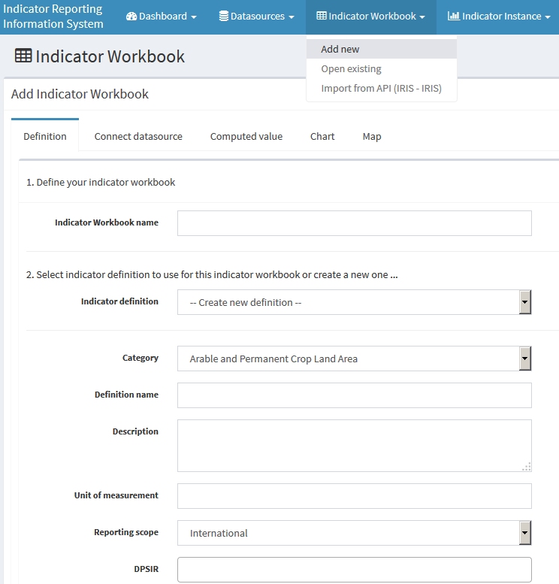
Indicator Workbooks
IRIS – Indicator Workbook

Slide 23
Indicator Instances - Charts

Slide 24
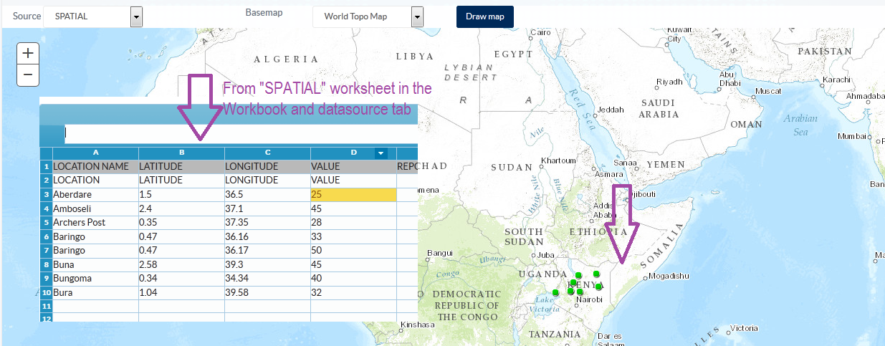
Indicator Instances - Maps

Slide 25
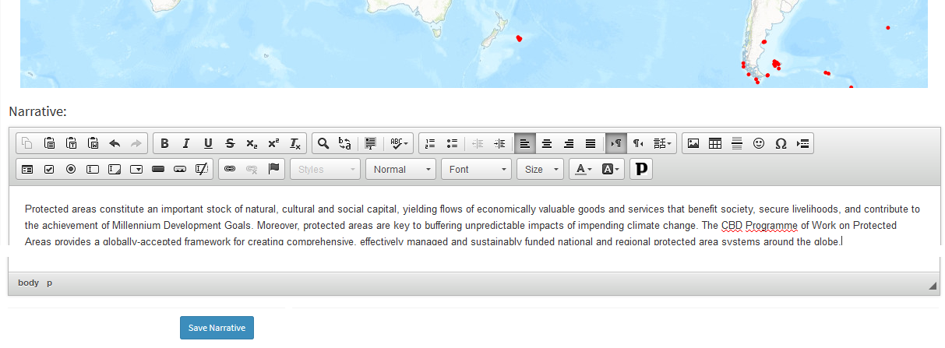
Narratives

Slide 26
Reports

Slide 27
Dashboard

Slide 28
UNEP Live – uneplive.unep.org Contact us at: uneplive@unep.org

