Slide 1

The Emissions Gap Report 2017
What is the 2030 emissions gap?
More ambitious NDCs are needed already by 2020
to be able to close the gap
Geneva ♦ 31 October, 2017

Slide 2






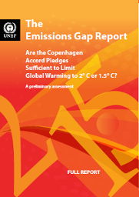







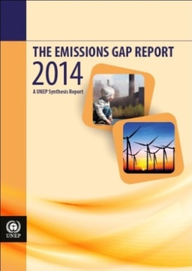


UN Environment Emissions Gap Reports

Slide 3
2017 Gap Report – main questions
What are we aiming for?
Keeping temperature increase well below 2ºC and pursue 1.5ºC as the goal of Paris Agreement
What is the pre-2020 contribution?
Collectively countries are on a track to meet their Cancun pledges, but these are NOT sufficiently ambitious to establish a path that will get the world to 2030 emission levels consistent with the well below 2ºC and 1.5ºC goal
What will NDCs contribute?
Emission levels resulting from NDCs are 4 to 6 GtCO₂e/yr lower than the current policy trajectory in 2030, but the remaining Gap is in the order of 11 to 13,5 GtCO₂e/yr compared with 2ºC scenarios and 16 to 19 GtCO₂e/yr compared with 1.5ºC
Will this be sufficient to stay well below 2°C?
Without enhanced ambition the likely global average temperature increase will be in the range of 3.0 - 3.2°C by the end of the century. The carbon dioxide budget for the 2ºC scenario will be close to depleted by 2030, and the 1.5ºC budget exceeded by far
Can the 2030 Gap be bridged - and how?
Sectoral emission reduction potentials in 2030 are sufficient to bridge the Gap
Kigali Amendment and reductions in Short Lived Climate Pollutant (SLCP) emissions can contribute in the longer-term
Gradual coal phase-out will be critical as will carbon dioxide removal
Non-state action initiatives will be an important part of equation

Slide 4
Global CO₂ emissions from fossil fuel and industry seem to stabilise while total GHG emissions still increase slowly
Notes:
In 2015, global CO₂ emissions stagnated for the first time and showed signs of a weak decline. Prior to 2015, global CO₂ emissions increased by roughly 1.3 percent/yearfor the period 2012 to 2014, which was significantly slower than that of the 12 preceding years, where the average increase was 2.9 percent / year (2000-2011), but higher than the average growth rate of around 1 percent/year during the 1990s. These findings are in line with other studies on trends in global energy-related CO₂ emissions.
In summary, global greenhouse gas emissions continue to grow, and while the indications are encourging that the growth rate of global CO₂ emissions from fossil fuels and cement production is slowing, it is still too early to say whether this is likely to be permanent.

Slide 5
Progress towards achieving the 2020 pledges for the G20 members
Collectively, G20 members are on a likely track to meet the middle range of their Cancun pledges
China, India, Japan and the EU are on track to meet their 2020 pledges; Australia, Brazil, and Russia are also are on track according to most estimates
Canada, Mexico, the Republic of Korea, South Africa and the United States are likely to require further action and/or purchased offsets in order to meet their 2020 pledges.
For Indonesia information is insufficient to assess Cancun pledge alignment.
Argentina, Saudi Arabia and Turkey have no Cancun pledges but have post-2020 pledges in their NDCs
Notes:
Collectively, G20 countries are on a likely track to meet the minimum level of the Cancun pledges, but these pledges do not deliver the necessary early emission reductions.
Early action is important, and in particular for the major emitting G20 members, as they account for approximately three quarters of the global emissions.
Most of the G20 members at COP 16 in Cancun formalised the emission reduction pledges they had put forward as a follow up to the Copenhagen Accord.
Since Cancun the UNEP Gap reports have assessed the progress countries are making towards delivering on these pledges.
The main findings are given here:
China, India and the EU are on track to meet the 2020 pledges; Brazil, Japan, and Russia are also are on track according to most estimates
Canada, Mexico, South Korea and the United States are likely to require further action and/or purchased offsets in order to meet their 2020 pledges.
For South Africa, Indonesia information is insufficient to assess Cancun pledge alignment. For Australia no conclusion is drawn regarding pledge attainment, due to disagreement on the budget and the target approach are used.
Note: On Australia, they are quite transparent and the information is sufficient; the problem as I understand it is that there is disagreement about whether the budget approach versus the target year approach should be used

Slide 6
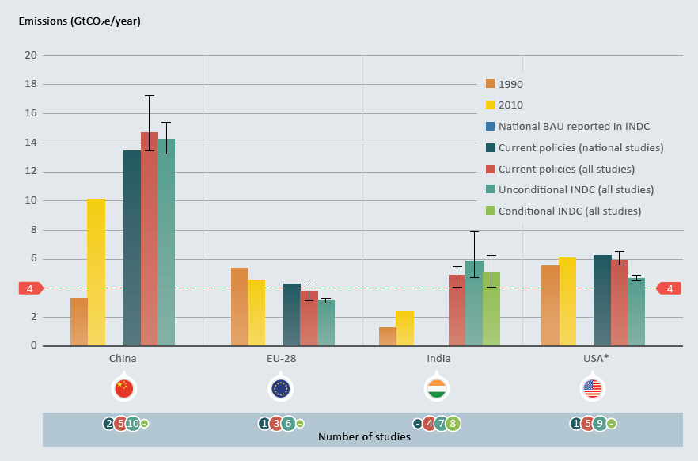
Understanding the mitigation efforts of the NDCs at country level
GHG emissions under the NDC, current policies & BAU scenario for G20 members in 2030
Notes:
Results of the assessment are presented for all the individual G20 members including the EU group in figure with the data sourced from the ten model groups and official & independent country-specific sources. Noting that data are not available for all countries.

Slide 7
Most G20 members require new policies and action to achieve their NDC pledges
Recent studies suggest that Brazil, China, India and Russia are likely to achieve their unconditional 2030 targets with currently implemented policies
Argentina, Australia, Canada, the European Union, Indonesia, Japan, Mexico, South Africa and the United States are likely to require further action in order to meet their NDCs, according to government and independent estimates
From the existing studies, it is not possible to determine whether Saudi Arabia and Turkey are on track to meet their NDCs
Additional research is necessary as the uncertainty ranges overlap for many countries and since the number of studies available for the current policy trajectory case and the NDC cases vary significantly
Notes:
Collectively, G20 countries are on a likely track to meet the minimum level of the Cancun pledges, but these pledges do not deliver the necessary early emission reductions.
Early action is important, and in particular for the major emitting G20 members, as they account for approximately three quarters of the global emissions.
Most of the G20 members at COP 16 in Cancun formalised the emission reduction pledges they had put forward as a follow up to the Copenhagen Accord.
Since Cancun the UNEP Gap reports have assessed the progress countries are making towards delivering on these pledges.
The main findings are given here:
China, India and the EU are on track to meet the 2020 pledges; Brazil, Japan, and Russia are also are on track according to most estimates
Canada, Mexico, South Korea and the United States are likely to require further action and/or purchased offsets in order to meet their 2020 pledges.
For South Africa, Indonesia information is insufficient to assess Cancun pledge alignment. For Australia no conclusion is drawn regarding pledge attainment, due to disagreement on the budget and the target approach are used.
Note: On Australia, they are quite transparent and the information is sufficient; the problem as I understand it is that there is disagreement about whether the budget approach versus the target year approach should be used

Slide 8
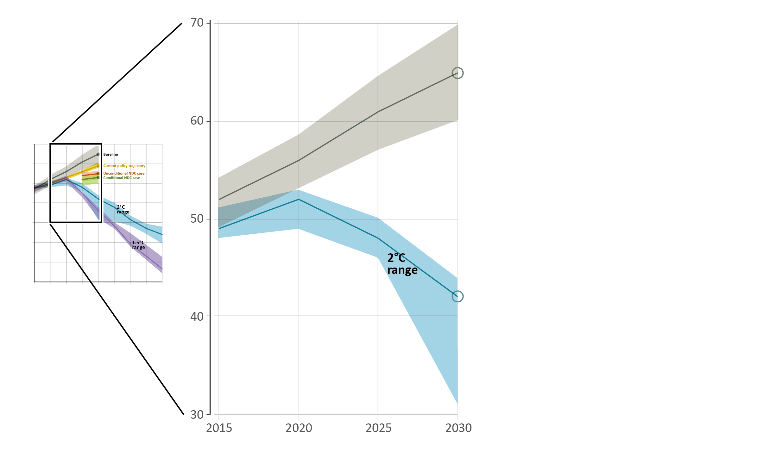
NDC contributions and the emissions gap
Annual global total greenhouse gas emissions (GtCO₂e)
Baseline
Global total emissions:
65 GtCO₂e (range: 60-70)
2°C pathways
Global total emissions:
42 GtCO₂e (range: 31-44)

Slide 9
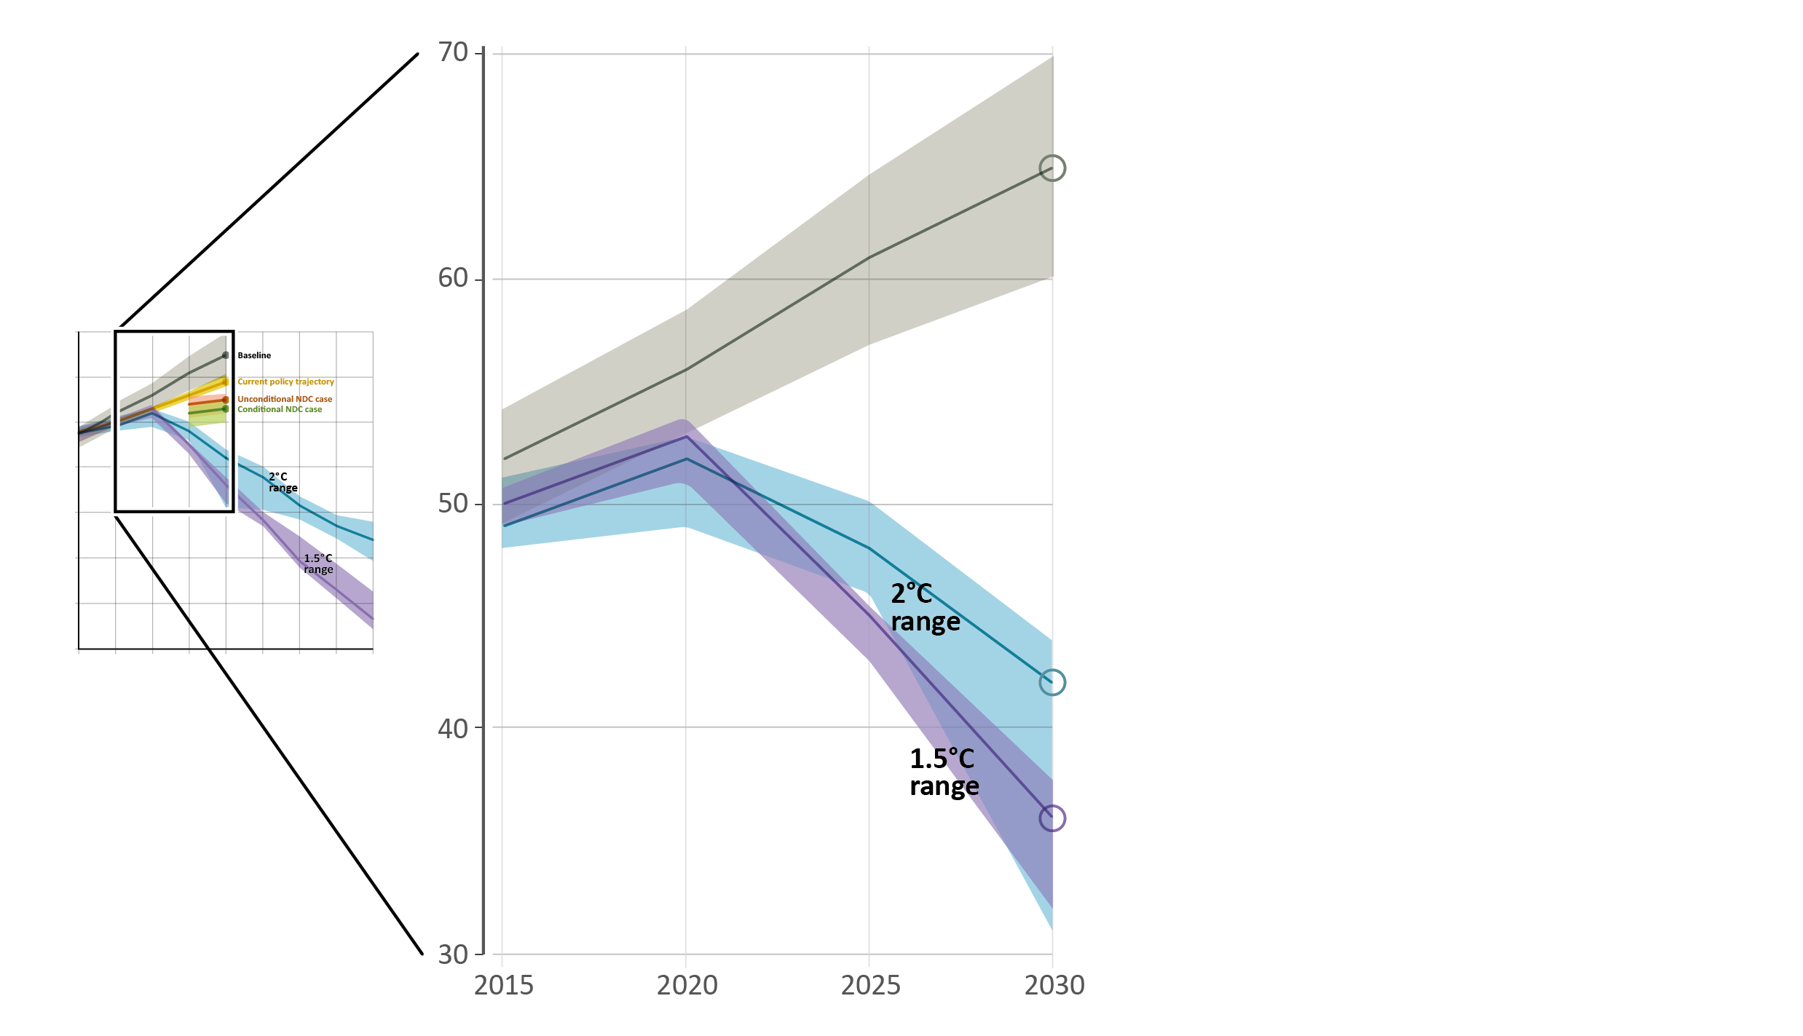
NDC contributions and the emissions gap
Annual global total greenhouse gas emissions (GtCO₂e)
Baseline
Global total emissions:
65 GtCO₂e (range: 60-70)
Baseline
Global total emissions:
65 GtCO₂e (range: 60-70)
2°C pathways
Global total emissions:
42 GtCO₂e (range: 31-44)
1.5°C pathways
Global total emissions:
37 GtCO₂e (range: 32-38)
1.5°C pathways
Global total emissions:
36 GtCO₂e (range: 32-38)

Slide 10
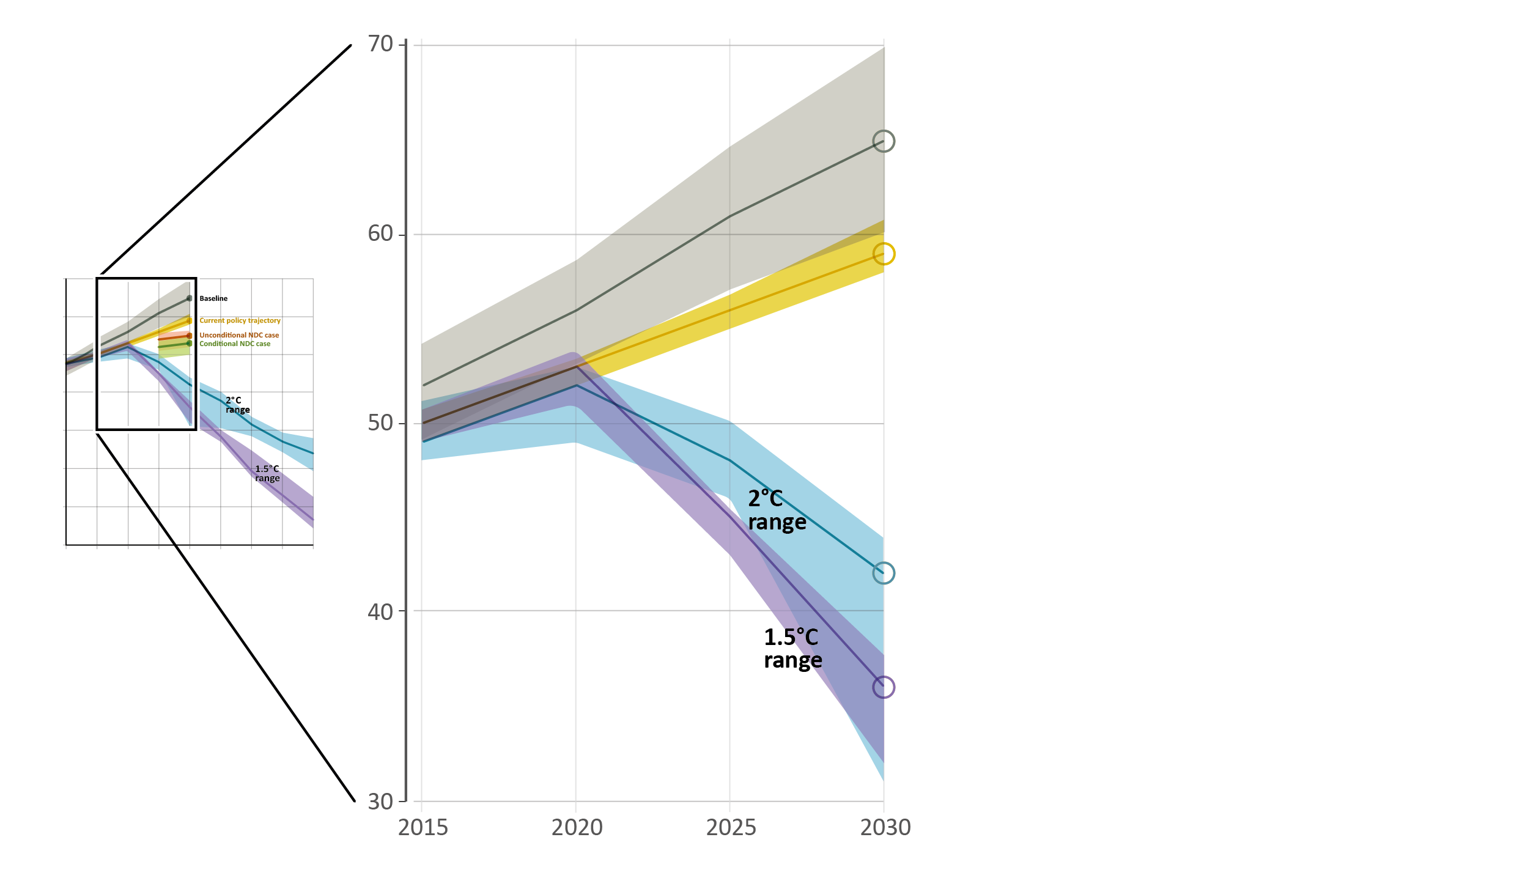
NDC contributions and the emissions gap
Annual global total greenhouse gas emissions (GtCO₂e)
Baseline
Global total emissions:
65 GtCO₂e (range: 60-70)
Current policy trajectory
Global total emissions:
59 GtCO₂e (range: 58-61)
2°C pathways
Global total emissions:
42 GtCO₂e (range: 31-44)
1.5°C pathways
Global total emissions:
36 GtCO₂e (range: 32-38)

Slide 11
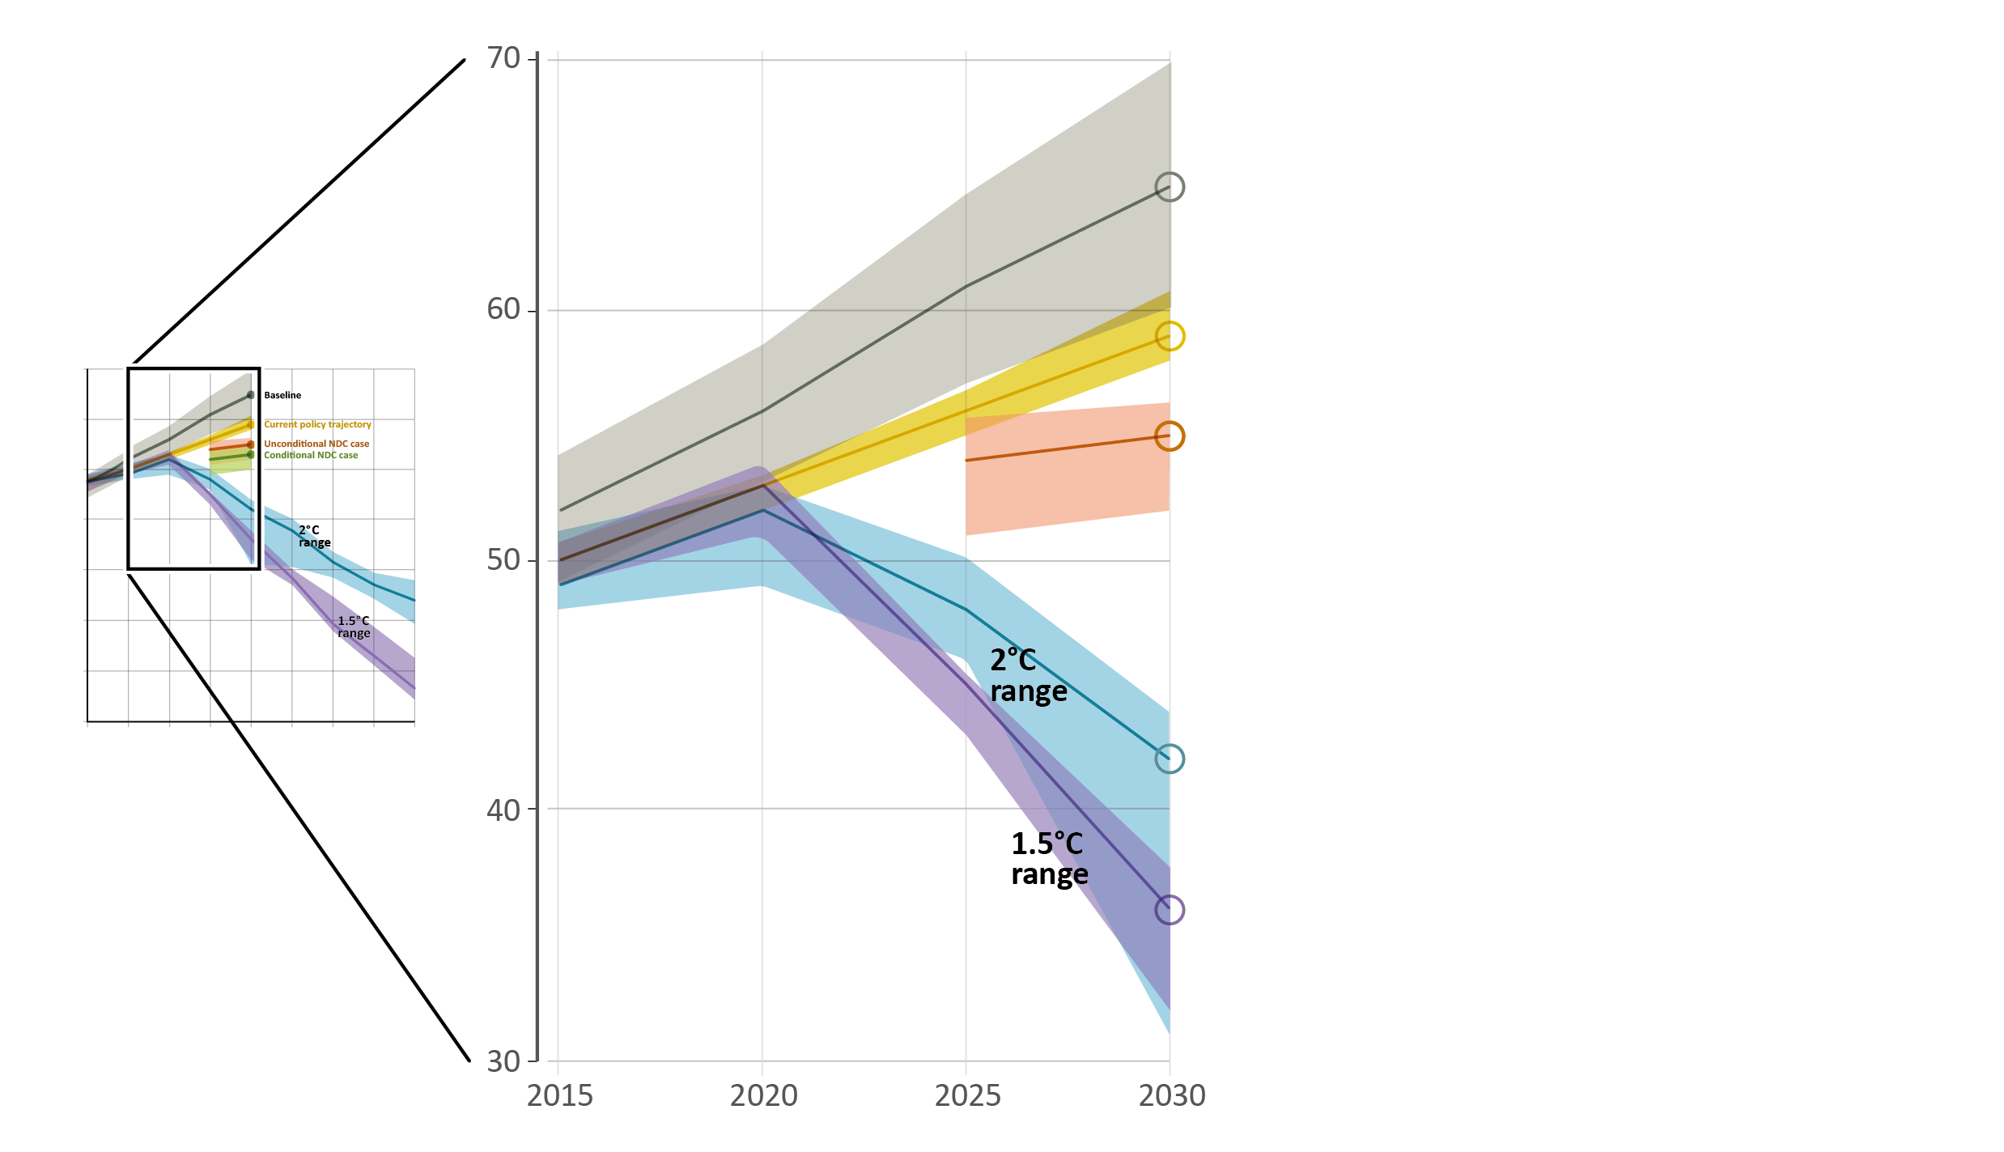
NDC contributions and the emissions gap
Annual global total greenhouse gas emissions (GtCO₂e)
Baseline
Global total emissions:
65 GtCO₂e (range: 60-70)
Baseline
Global total emissions:
65 GtCO₂e (range: 60-70)
Current policy trajectory
Global total emissions:
60 GtCO₂e (range: 58-62)
Current policy trajectory
Global total emissions:
59 GtCO₂e (range: 58-61)
Unconditional NDC case
Global total emissions:
55 GtCO₂e (range: 52-56)
2°C pathways
Global total emissions:
42 GtCO₂e (range: 31-44)
2°C pathways
Global total emissions:
42 GtCO₂e (range: 31-44)
1.5°C pathways
Global total emissions:
39 GtCO₂e (range: 38-40)
1.5°C pathways
Global total emissions:
36 GtCO₂e (range: 32-38)

Slide 12
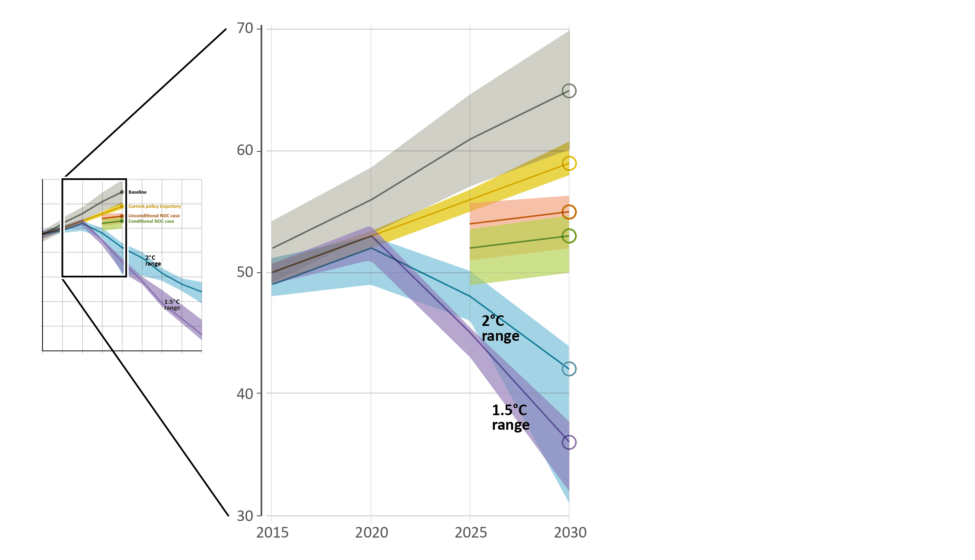
NDC contributions and the emissions gap
Annual global total greenhouse gas emissions (GtCO₂e)
Baseline
Global total emissions:
65 GtCO₂e (range: 60-70)
Current policy trajectory
Global total emissions:
59 GtCO₂e (range: 58-61)
Unconditional NDC case
Global total emissions:
55 GtCO₂e (range: 52-56)
Conditional NDC case
Global total emissions:
53 GtCO₂e (range: 50-54)
2°C pathways
Global total emissions:
42 GtCO₂e (range: 31-44)
1.5°C pathways
Global total emissions:
36 GtCO₂e (range: 32-38)

Slide 13
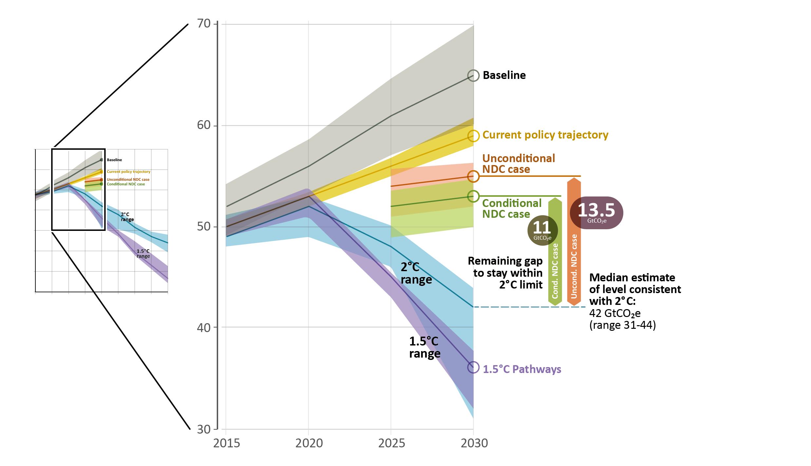
NDC contributions and the emissions gap
Annual global total greenhouse gas emissions (GtCO₂e)
Unconditional NDC case (for 2˚C)
Gap= 13.5 GtCO₂e
Conditional NDC case (for 2˚C)
Gap= 11 GtCO₂e

Slide 14
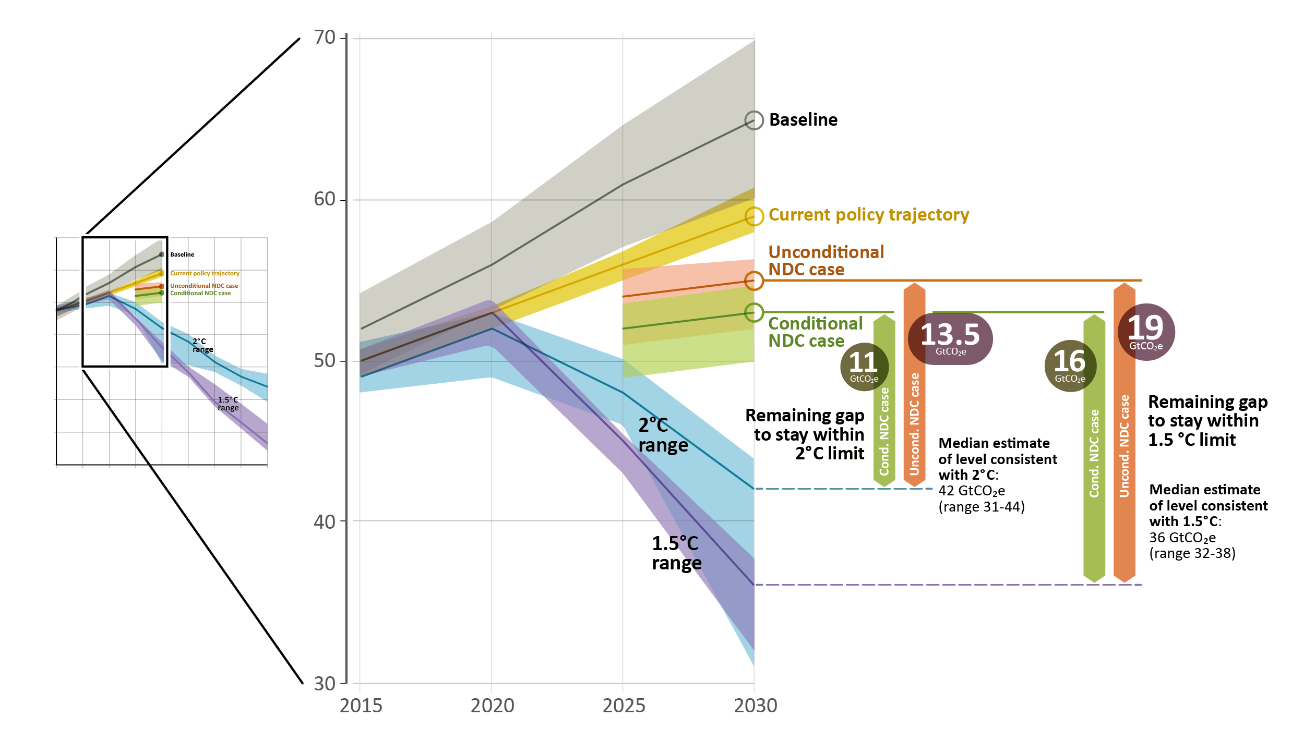
NDC contributions and the emissions gap
Annual global total greenhouse gas emissions (GtCO₂e)
Unconditional NDC case (for 2˚C)
Gap= 13.5 GtCO₂e
Conditional NDC case (for 2˚C)
Gap= 11 GtCO₂e
Unconditional NDC case (for 1.5˚C)
Gap= 19 GtCO₂e
Conditional NDC case (for 1.5˚C)
Gap= 16 GtCO₂e

Slide 15
NDC contributions and the emissions gap
Annual global total greenhouse gas emissions (GtCO₂e)
NDCs represent a first start to initiate the required transition, but are far from consistent with the well below 2ºC / 1.5ºC temperature goals
Full implementation of unconditional NDCs is consistent with staying below a 3.2ºC temperature increase by 2100. Additional implementation of conditional NDCs lowers this by about 0.2ºC
By 2030, carbon dioxide budgets for a likely chance of limiting temperature increase to below 2ºC will be close to depleted under NDC implementation and well exceeded for the 1.5ºC target

Slide 16
Sectoral emission reduction potentials in 2030
The emissions reduction potential in six key sectors, at cost <US$100/tCO₂e, is sufficient to close the emissions gap in 2030 - if implemented immediately and at scale
Such action would provide benefits for other important environmental, social and economic goals

Slide 17
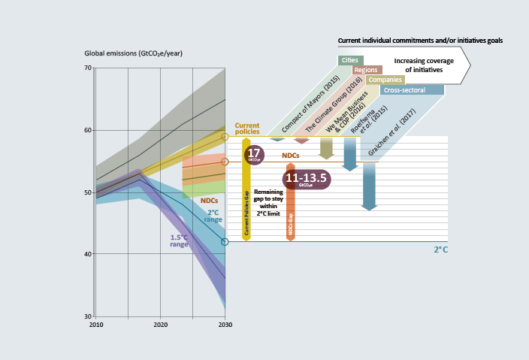
Non-state actors will play an important role
More than 12,000 climate commitments
Credibility and transparency varies between initiatives
Enhanced monitoring and reporting essential to make pledged actions transparent and credible
Contribution to closing the Emissions Gap may be significant

Slide 18
Role of coal in (not?) closing the Gap
A gradual phase-out of coal is needed if the climate goals are to be achieved

Slide 19
Role of coal in (not?) closing the Gap
Today: 6,683 operating coal-fired power plants in the world with combined installed capacity of 1,964 GW

Slide 20
Role of coal in (not?) closing the Gap
273 GW of coal-fired capacity additionally under construction and 570 GW in the planning stage

Slide 21
Role of coal in (not?) closing the Gap
However: a large number of planned power plants shelved or cancelled in 2016, and slower rate of coal expansion globally

Slide 22
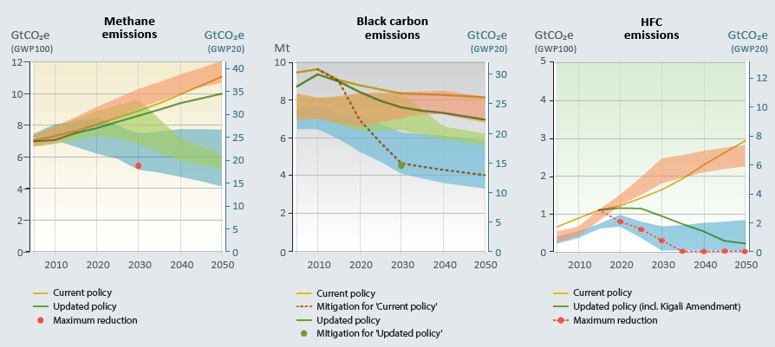
Contributions from Short-Lived Climate Pollutants
Mitigation of SLCPs will limit the rate of short-term warming and, when sustained and combined with CO₂ reductions, will help limit long-term warming
The Kigali Amendment kicks-in too late to impact the 2030 emissions gap, but can make a real contribution to reaching the longer term temperature goals
Notes:
UN Environment will in 2018 undertake a new specific assessment to shed more light on the impacts of implementing the Kigali Amendment.

Slide 23
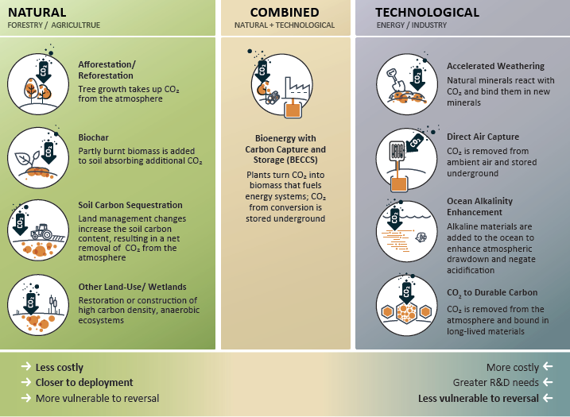
Carbon dioxide removal can contribute
Biological CO₂ removal can play an immediate role, and can also significantly contribute to achieving several other SDGs. Technological options like direct air capture and mineralization are still at pilot stage

Slide 24
More ambitious NDCs necessary by 2020
Without enhanced ambition the likely global average temperature increase will be in the range of 3.0 - 3.2°C by the end of the century. The carbon dioxide budget for the 2ºC scenario will be close to depleted by 2030, and the 1.5ºC budget well exceeded
The Emissions Gap in 2030 is in the order of 11 to 13.5 GtCO₂e/yr compared with 2ºC scenarios and 16 to 19 GtCO₂e/yr compared with 1.5ºC
The Facilitative Dialogue in 2018 and the 2020 revisions of the NDCs are the last opportunity to get on a path to close the 2030 emissions gap
Enhanced ambitions should build on the existing, extensive knowledge about the cost-effective policies and measures that can be taken total sectoral emission reduction potentials presented in the report amounts to 30–36 GtCO₂e, which is more than double the 2030 emissions gap

Slide 25
The Emissions Gap Report 2017
Thank you
Geneva ♦ 31 October, 2017

